Slide 1


PHARMACOLDOPS
PharmaColdOps
An Intelligent System for Temperature-Excursion Disposition and Delivery Re-routing in Cold-Chain Pharmaceuticals
Project Group 41 · Xu Wenzhe · Zhu Jianyu · Wang Lepeng · Shen Ziyi
A0328771W · A0353769L · A0357864L · A0350940J
IRS Practice Module · Proposal Presentation · 29 Sep 2026

Slide 2
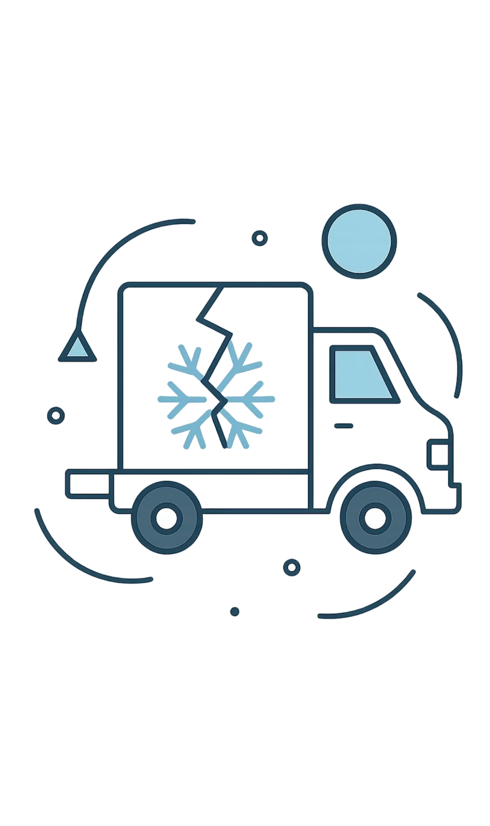
Cold-Chain Excursions Threaten Drug Safety
Temperature-Sensitive Products
Manual, Inconsistent Decisions
Vaccines and biologics can lose efficacy after even a brief deviation in transport or storage.
Common tools only raise an alarm: they record the deviation but do not decide what to do with the batch.
Mixed Handling, Weak Traceability
Practices vary by site and shift; the reasoning behind a disposition is rarely reconstructable.

Slide 3



GAP ANALYSIS
Where Existing Tools Fall Short
Fragmented, Not Absent
Disconnected Workflows
Black-Box AI
Monitoring exists; what is missing is a rule path linking the disposition to the order, route and evidence.
Disposition decisions and logistics re-routing exist in separate, siloed systems with no automated handoff.
A recommendation that cannot show its rule, evidence and limits will not be signed off in an audit.

Slide 4

Our Solution: PharmaColdOps
A closed-loop decision system that acts the moment an excursion is detected — with full regulatory grounding and audit readiness.
01
02
03
Explainable Disposition
Automated Re-routing
Regulatory Grounding
Four outcomes with a traceable rule path; reshipment is a separate logistics action.
A reshipment order solved as a capacity- and time-window routing problem.
Every decision cites its rule, regulation or SOP and evidence limits.

Slide 5
Where PharmaColdOps Sits
POSITIONING · MARKET CONTEXT AND RELATED WORK
Commercial platforms already monitor temperature and automate parts of the quality process — we do not claim to be first.
We build on existing foundations: Solomon's VRPTW benchmark, OR-Tools, gradient-boosted trees, SHAP.
The gap we address is the unbroken, inspectable chain from event to disposition to order to route to cited evidence.

Slide 6





Data: Verifiable, Disclosed Provenance
Cold Chain Silent Failure (Kaggle)
Vaccine Distribution w/ Temp Logging (Kaggle)
Electric Sheep Africa Dataset
≈8,000 rows — failure classification.
Simulated facility-monthly records.
≈26,700 rows — sequence and MKT work.
CVRPLIB Benchmarks
Domain Rules
Six Solomon instances + OSM road network.
WHO / EU GDP / ICH · CDC. Thresholds are prototype assumptions.

Slide 7
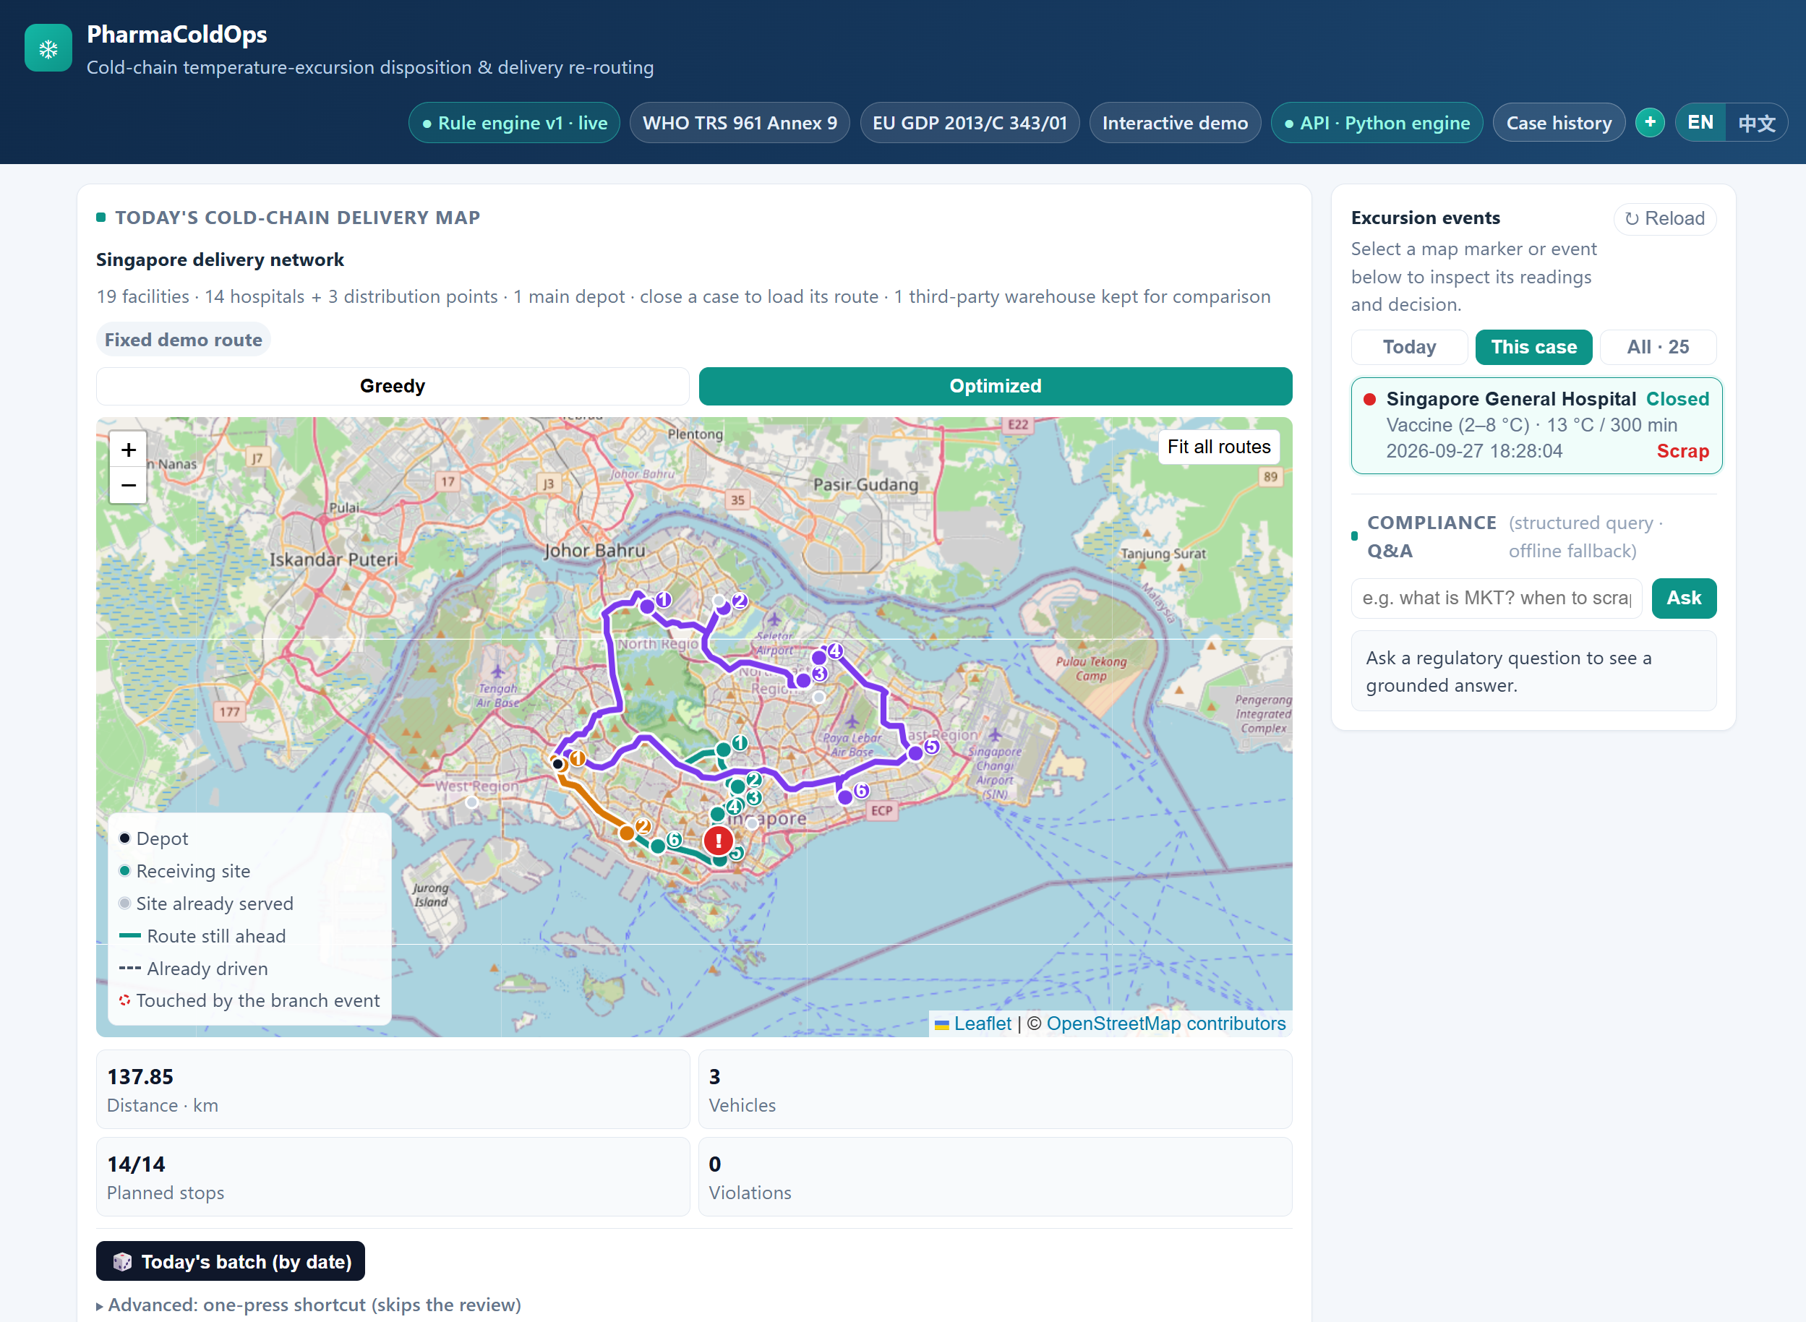
Built and Running Today
MEASURED FROM THE REPOSITORY, 2026-09-27
23 HTTP endpoints, 15 of them dispatch operations.
One Vue 3 client, 23 components; EN/ZH and offline mode.
25 archived cases; 56 dispatch operations persisted.
305 test functions across 34 test files.
Still missing: cloud deploy, de-duplication, destination pool.

Slide 8
The Loop Runs — and Every Number Reproduces
RESULTS AND PROGRESS · MEASURED FROM THE REPOSITORY, 2026-09-28
DISPOSITION LAYER
54/57 · κ = 0.6434
THE LOOP, END TO END
4
54/57 = 94.7% agreement against our own rubric.
dispositions the rule engine can assign:
release, quarantine, retest or scrap — reshipment is a separate logistics action, never a fifth outcome.
ROUTE LAYER
142.63 → 133.81 km
−6.19% vs greedy, 0 violations; Solomon optima in 10 s.
RISK LAYER
PROTOTYPE EVIDENCE, 2026-09-27
F1 0.691 / ROC-AUC 0.925
· one closed case → reshipment order → route on a real 19-node Singapore OSM network; graph evidence = 9 nodes / 8 relationship types (2026-09-13)
70/15/15 split; cause Top-1 0.143 vs majority baseline 0.161.
· live surface: 23 API paths / 24 operations, 15 dispatch paths; 25 archived cases and 56 persisted dispatch operations
· declared limits: simulated demand and time windows; no operational savings claimed

Slide 9



Risks, Team & Next Steps
Risk Mitigations
Team Roles
Annotator agreement κ = 0.6434 vs our 0.80 target → report it
Immediate Next Steps
Quarantine recall 0/3 3 gold cases → report support counts
W1: threshold review; multi-fold risk experiments
W3: integrated acceptance and failure states
W5: reproduce cleanly; videos by 25 Oct
Synthetic data suspected-synthetic → disclose the limit
Project Lead / Rules · Xu Wenzhe: rules, evidence, evaluation
Data & ML · Zhu Jianyu: data, risk, causes, SHAP
Optimisation · Wang Lepeng: VRPTW, routes, dispatch
KG + QA + Frontend · Shen Ziyi: KG, QA, API, frontend

Slide 10

WHAT WE COMMIT TO
Conclusion and Next Steps
1
The reasoning path exists and carries its own critique: rule-versus-judgement disagreement, a weak cause classifier, prototype thresholds.
2
All four IRS technique groups are covered, against a requirement of three.
3
By 25 Oct: integrated acceptance with failure states, clean-environment reproduction, the two videos.
4
It does not replace the quality lead's approval, and does not authorise real product release, destruction or transport.

